Slide 1




Web Services and Cloud
Web Services & Cloud Course Program, Evaluation, Exams
Web Services & Cloud
SoftUni Team
Technical Trainers
Software University
http://softuni.bg

Slide 2
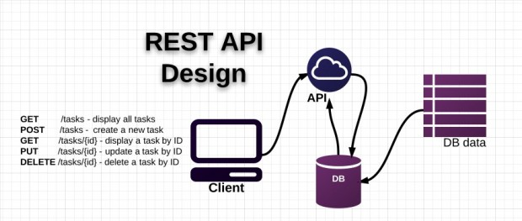


Table of Contents
Course Objectives
Course Program
Trainers Team
Examination
Learning Resources

Slide 3









SoftUni Diamond Partners

Slide 4

SoftUni: Levels, Modules, Schedule
Programming Basics
2 months
6 credits
Programming Fundamentals
36 credits
6 months
Advanced C#
Object-Oriented Programming
High-Quality Code
Java Basics
Teamwork and Personal Skills
Web Front-End
Back-End
36 credits
36 credits
HTML + CSS + WordPress
JavaScript Basics
Advanced JavaScript
Databases
Database Applications
Web Services and Cloud
6 months
JavaScript Applications
JavaScript Frameworks
PHP Web Development
ASP.NET MVC Web Development

Slide 5

Web Services and Cloud
Course Objectives & Program

Slide 6
Course Program
Course Introduction
Web Services Overview – SOA, SOAP, WSDL, REST, …
ASP.NET Web API – REST Services with C# and .NET
ASP.NET Web API Architecture – Workshop
Consuming Services with C#
Lab – Creating REST API
Cloud Technologies and Platforms

Slide 7

Database Apps – Course Program (2)
Deployment of REST Services in Cloud (Azure)
Exam Preparation
Practical Exam

Slide 8

The Trainers Team

Slide 9


Trainers Team
Atanas Rusenov
Technical Trainer @ Software University
Top performing student from the Software University (2014)
Nikolay Bankin
Software Engineer at Obecto
Top performing student from the Software University (2014)

Slide 10

Web Services and Cloud: More Details
Duration, Languages, Technologies

Slide 11


Training Duration – Web Services and Cloud
Lectures: ~ 16 hours (onsite + YouTube videos)
Practical exercises (in class): ~ 20 hours
Homework: ~ 40-50 hours
Teamwork project: ~ 10-20 hours
Schedule: April 2015
Practical exam: 19 April 2015

Slide 12



Why English?
Why the slides are in English?
English is the native language of the software engineers
Specific terminology should be in English
Translations are inaccurate and funny
Just learn English!
No excuses

Slide 13



Web Services and Cloud
Evaluation Criteria

Slide 14

Scoring System for the "WS and Cloud"
Practical Exam – 80%
Teamwork Project – 10%
Homework + Evaluation – 5% + 5%
Presence in class: 5% (onsite students only)
Bonuses: up to 10%

Slide 15

The Practical Exam
Web Services & Cloud Practical Exam
Design a RESTful web service with ASP.NET Web API
You will be given a description of the service endpoints
You will be given unit tests
Sample unit tests for each service endpoint
Your services will be evaluated against more detailed unit tests, covering all cases

Slide 16

Homework Assignments
Doing your homework is very important!
Programming can only be learned through a lot of practice!
You should write code every day!
Each lecture is followed by a few exercises
Try to solve them in class
The rest are your homework
Homework assignments are due in 1-2 weeks after each lecture
Submission will be accepted through our web site: softuni.bg

Slide 17

Homework Peer Reviews
Give feedback to a few random homework submissions
Students submit homework anonymously
Please exclude your name from the submissions!
For each homework submitted
Students evaluate 3 random homeworks
From the same topic, after the deadline
Give written feedback, at least 200 characters
Low-quality feedback → report for punishment
Everyone will get feedback for their homework

Slide 18








Resources
What We Need Additionally?

Slide 19

Course Web Site & Forums
The WS & Cloud official web site:
Register for the "Software University Forum":
Discuss the course exercises with your colleagues
Find solutions for all course exercises
Share source code / discuss ideas / help each other
softuni.bg/trainings/22/Web-Services-and-Cloud-Mar-2015
https://softuni.bg/forum

Slide 20



Database Applications Slides and Videos
All lecture slides, videos, homework assignments, projects and other resources are open content, available for free
Visit the course web site to access the course resources

Slide 21
Web Services and Cloud – Additional Resources
ASP.NET Web API Official Tutorials
http://www.asp.net/web-api
Build RESTful API's with ASP.NET Web API
http://www.asp.net/web-api/overview/older-versions/build-restful-apis-with-aspnet-web-api

Slide 22
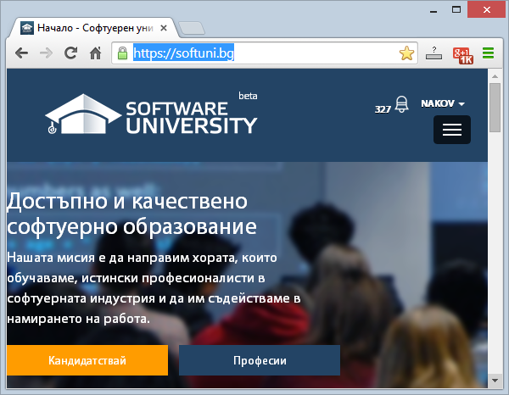
Software University Learning System (SULS)
Software University Learning System (SULS)
www.softuni.bg
Important resource for students
Homework submissions
Homework check-up
Exams and results
Reports about your progress
…

Slide 23
Recommended Software
Visual Studio Community 2013
Microsoft SQL Server 2014 (Express or Standard Edition) + SQL Server Management Studio 2014
SQL Server 2012 may work as well
Postman REST Client
Azure Tools for Microsoft Visual Studio

Slide 24




Database Applications – Course Introduction
https://softuni.bg/courses/web-services-and-cloud/

Slide 25
License
This course (slides, examples, demos, videos, homework, etc.) is licensed under the "Creative Commons Attribution-NonCommercial-ShareAlike 4.0 International" license
Attribution: this work may contain portions from
"Web Services and Cloud" course by Telerik Academy under CC-BY-NC-SA license

Slide 26






Free Trainings @ Software University
Software University Foundation – softuni.org
Software University – High-Quality Education, Profession and Job for Software Developers
softuni.bg
Software University @ Facebook
facebook.com/SoftwareUniversity
Software University @ YouTube
youtube.com/SoftwareUniversity
Software University Forums – forum.softuni.bg

